Slide 1
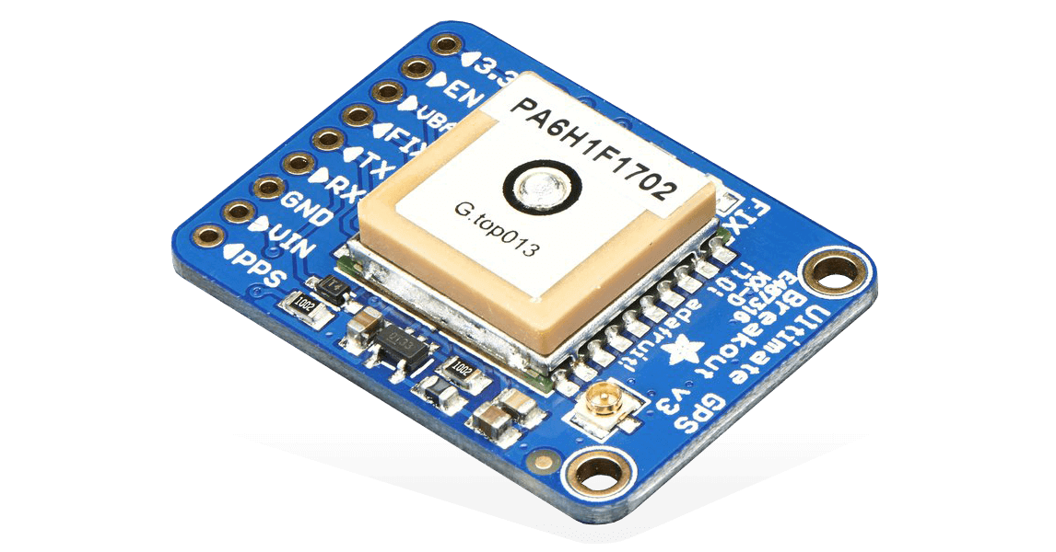
MTK3339 – Adafruit Ultimate GPS Sensor
Hardware Production: CENG 317-0NB
November 26th, 2019
By: Ricky Ramnath – N01094968

Slide 2

Introduction
For my hardware, I chose the Adafruit Ultimate GPS Breakout. This will be able to display location. My goal is to make the project scalable from one location to several for our Capstone Project.
GPS: Global Positioning Systems are receivers with antennas that use a satellite-based navigation system with a network of about 24 satellites in orbit around the earth to provide position, velocity, and timing information.
Additionally, the GPS will prioritize orders by accessing location from students and finding out how long it will take for student to arrive to the parts crib. From that we will know which orders to get ready first in priority sequence based on travel time.
To enhance the user experience, having a GPS Sensor is crucial to detect which parts crib data belong to which.

Slide 3

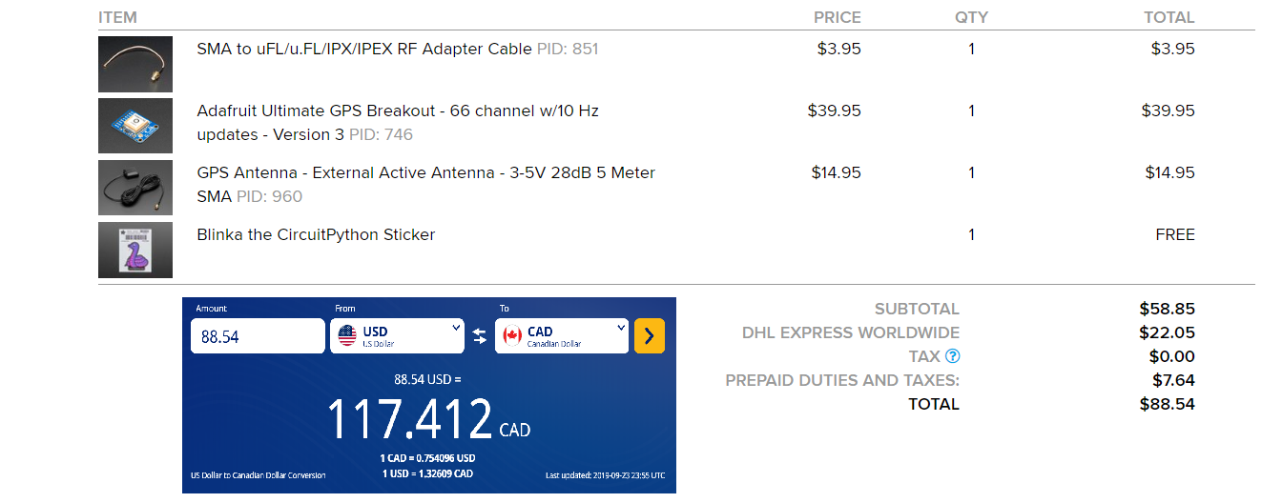
Budget

Slide 4

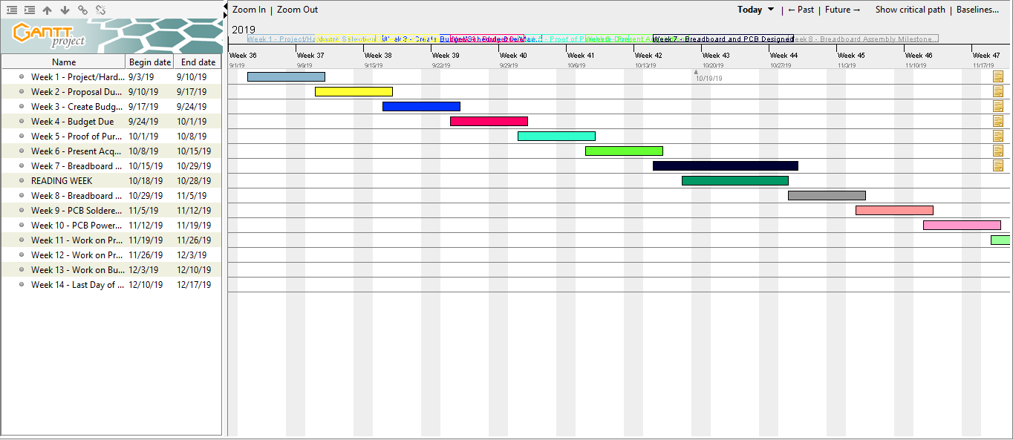
Schedule

Slide 5
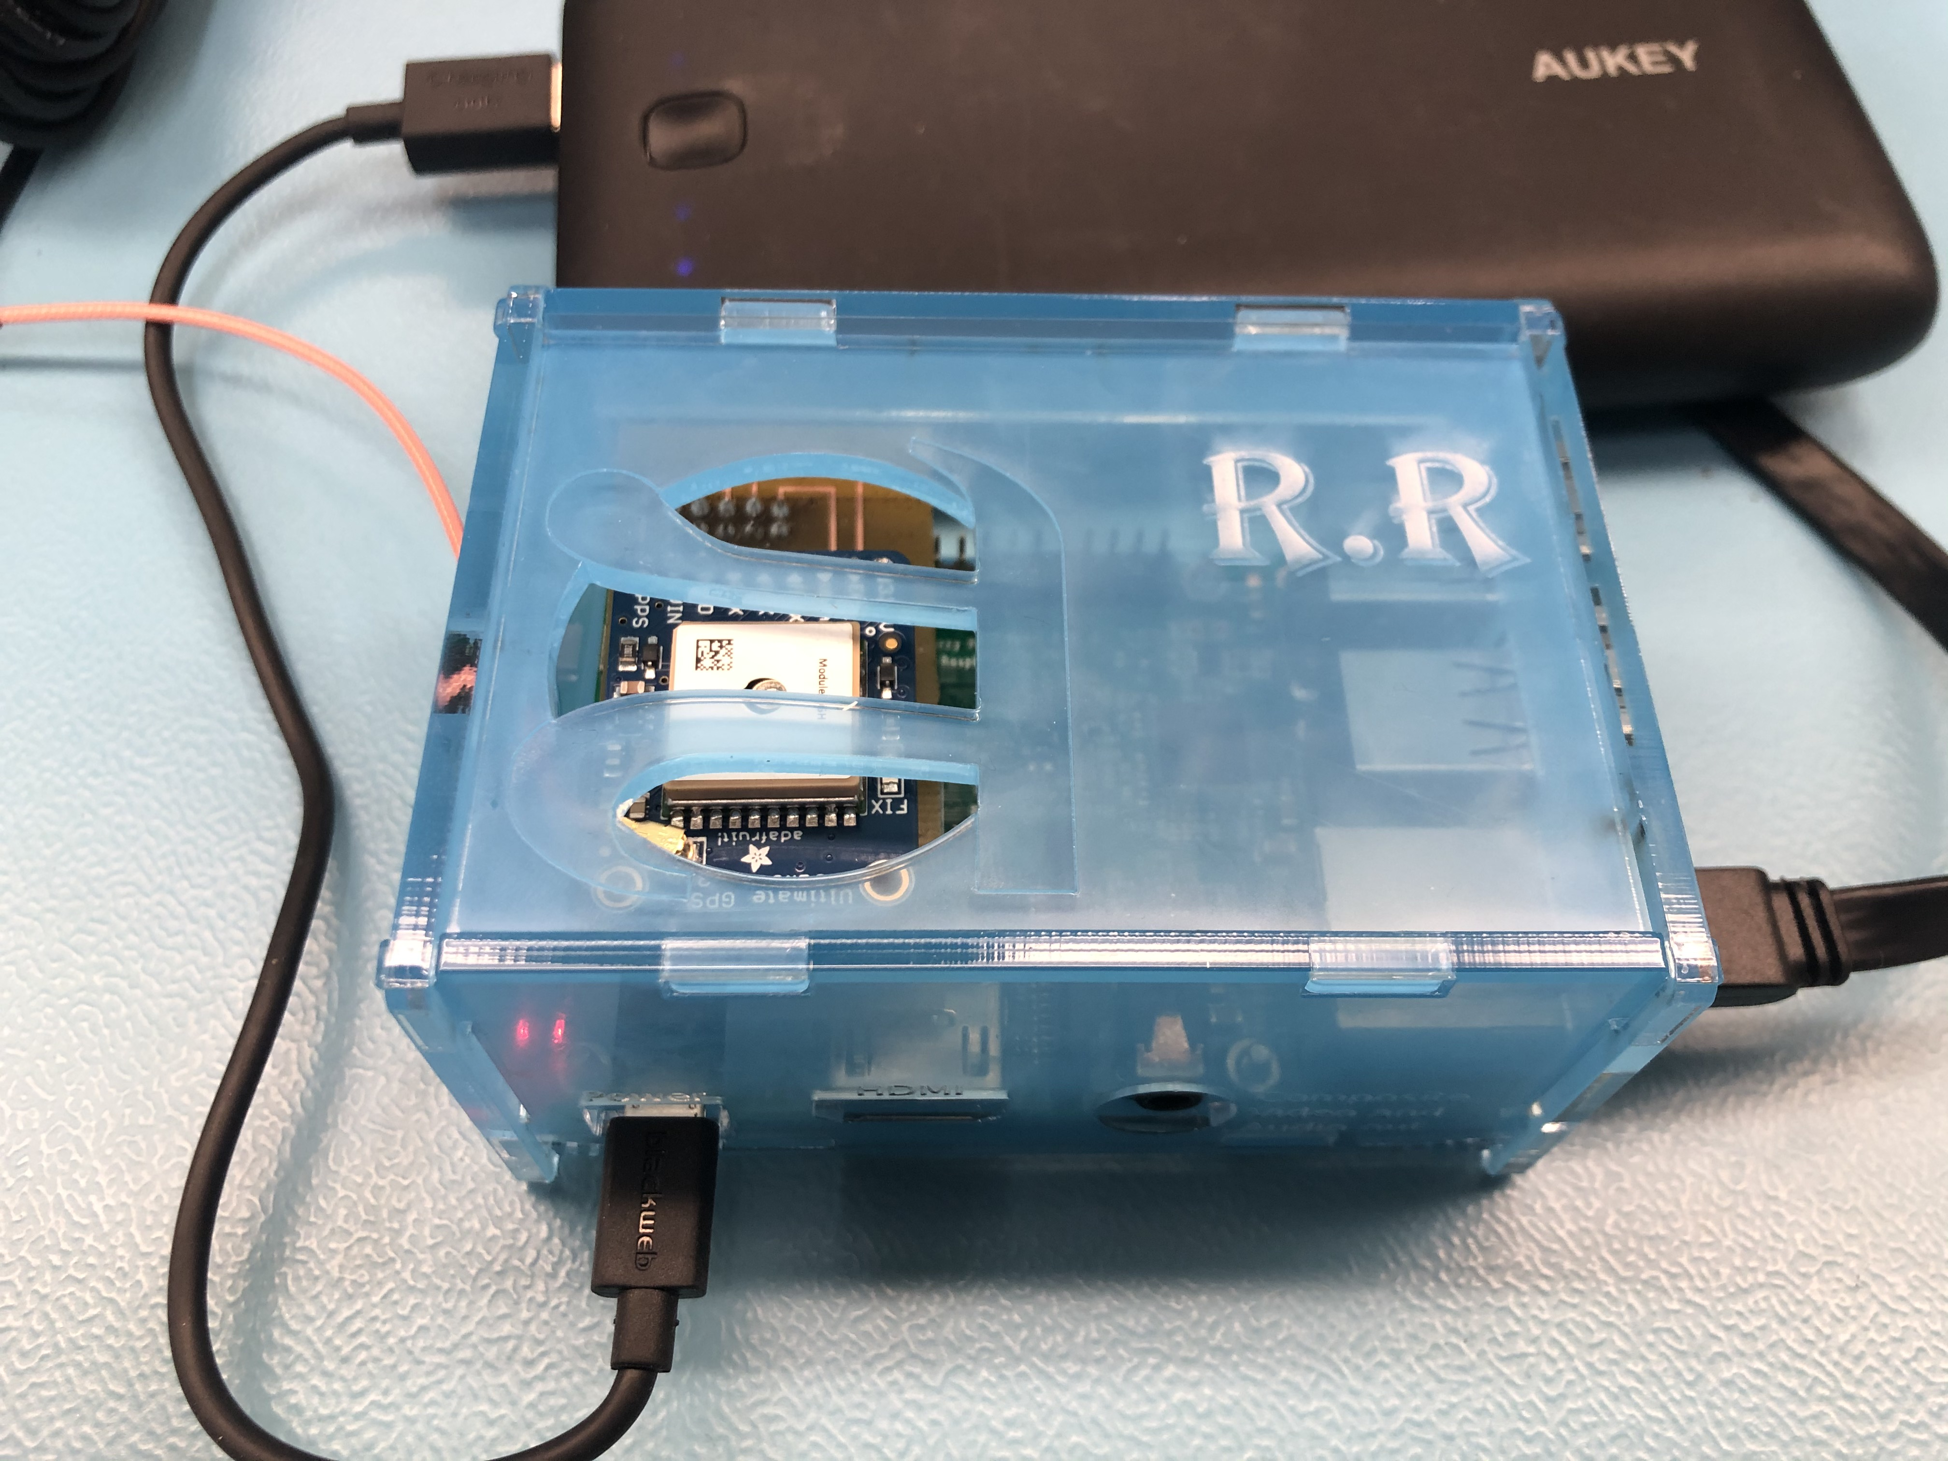

Enclosure

Slide 6


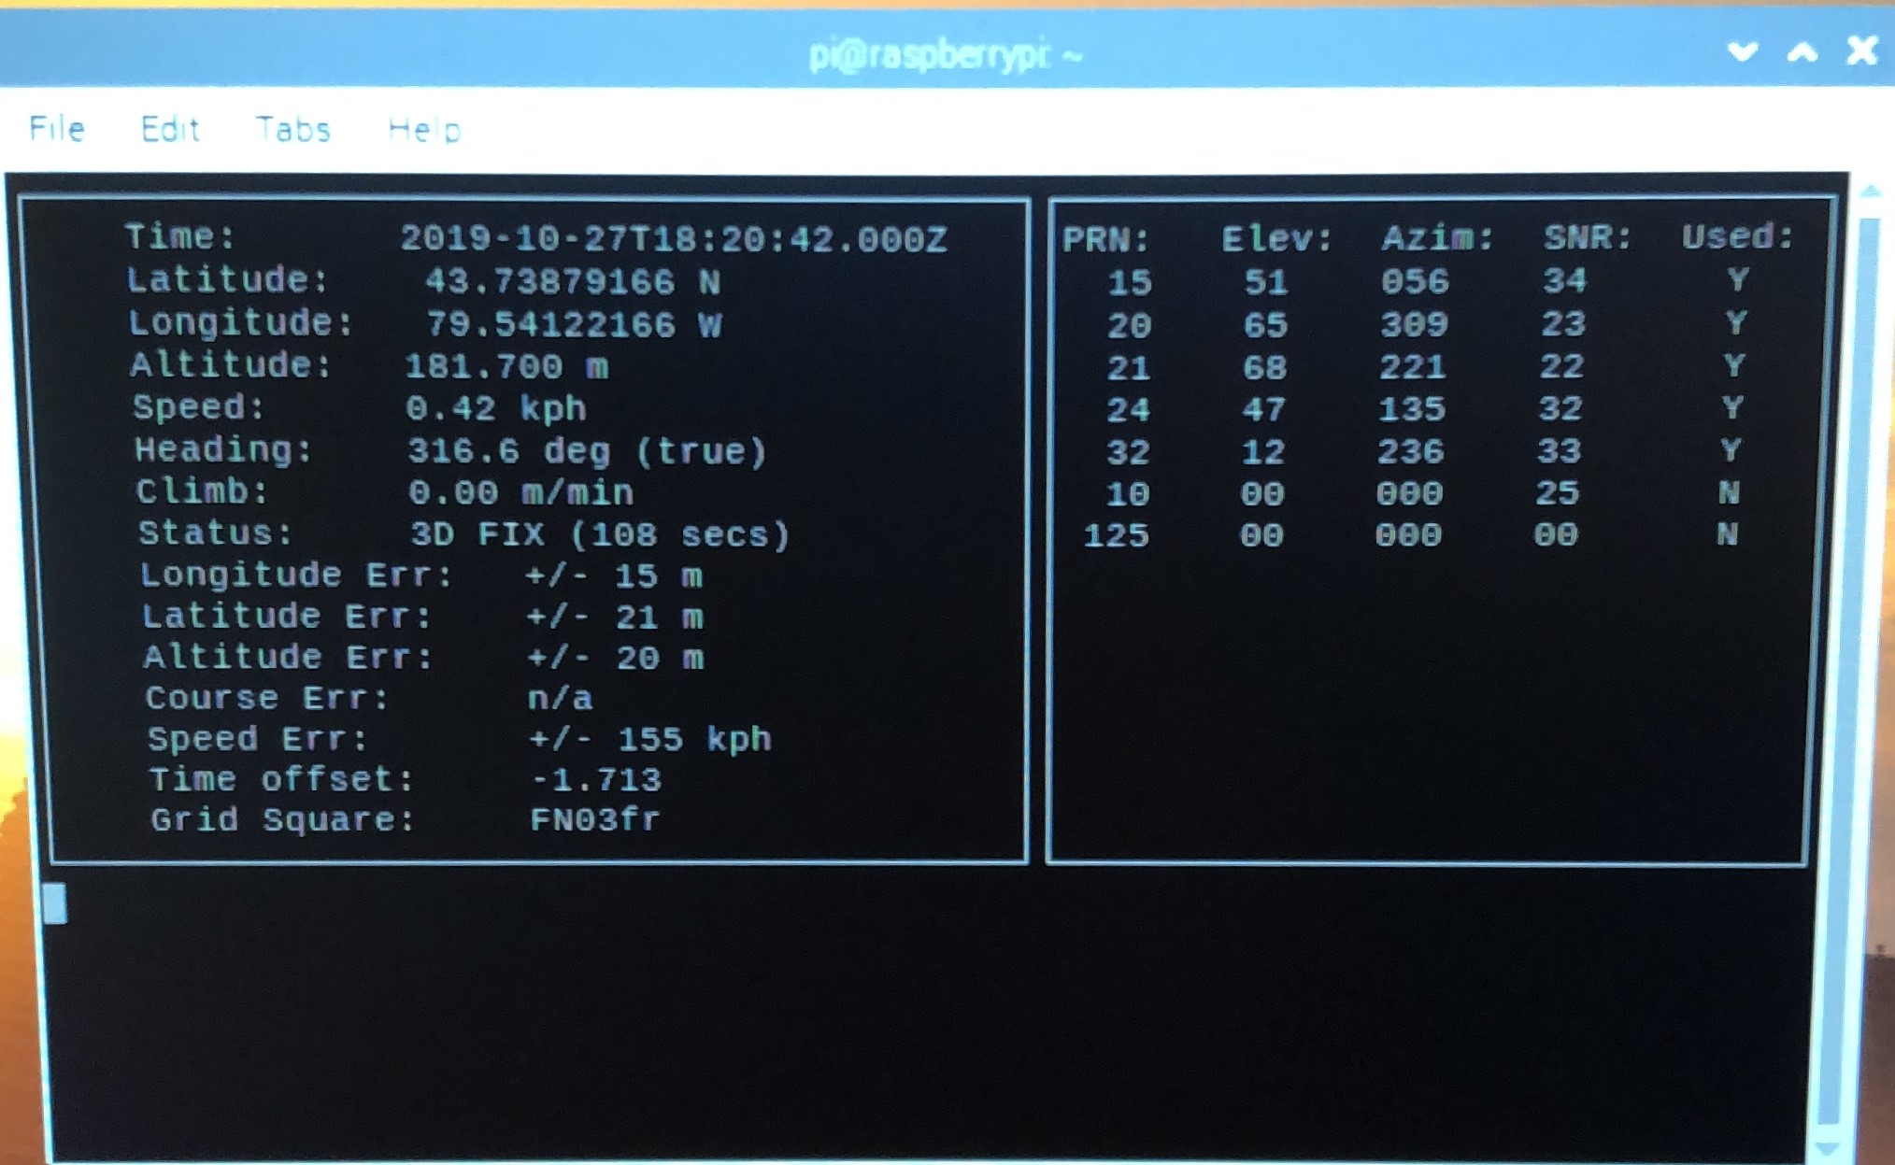
READINGS
This sensor reads:
Time
Longitude
Latitude
Altitude
Speed…etc

Slide 7

Course Knowledge
WRIT 120 + 220: Properly write a blog.
CENG 251: Familiarize with UNIX Environment.
CENG 212: Programming Skills
CENG 252: Learned about the raspberry pi, microprocessors and how they work.
TECH 101: Learned how circuits work in order to solder.
CENG 216: Learned about Gantt Projects/Charts and assisted with documents.
Notes:
Soldering
Coreldraw – learned how to design a case for the project
Github – learned how to contribute to projects
Raspberry Pi – learned to set up and configure the RPi for an SPI device

Slide 8

GitHub Blog
https://rickyramnath97.github.io/gps/

